Slide 1



Accounting for population structure
Structure population models in phylodynamics
Nicola Felix Müller, PhD
e-mail: nicola.felix.mueller@gmail.com
twitter: @nicfelm

Slide 2
Phylogenetic trees are formed by population processes and contain information about them

Slide 3
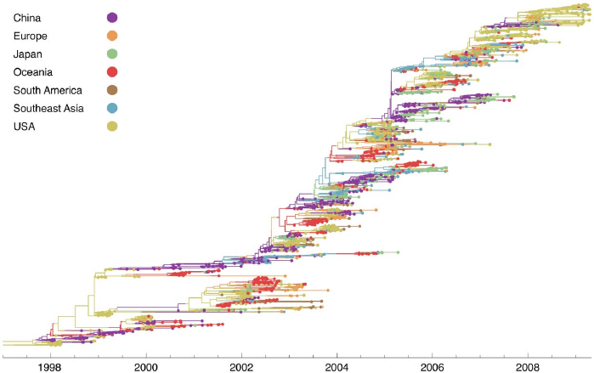
H3N2 sequences show spatial clustering
Bedford et al., 2010, PLoS Path.

Slide 4
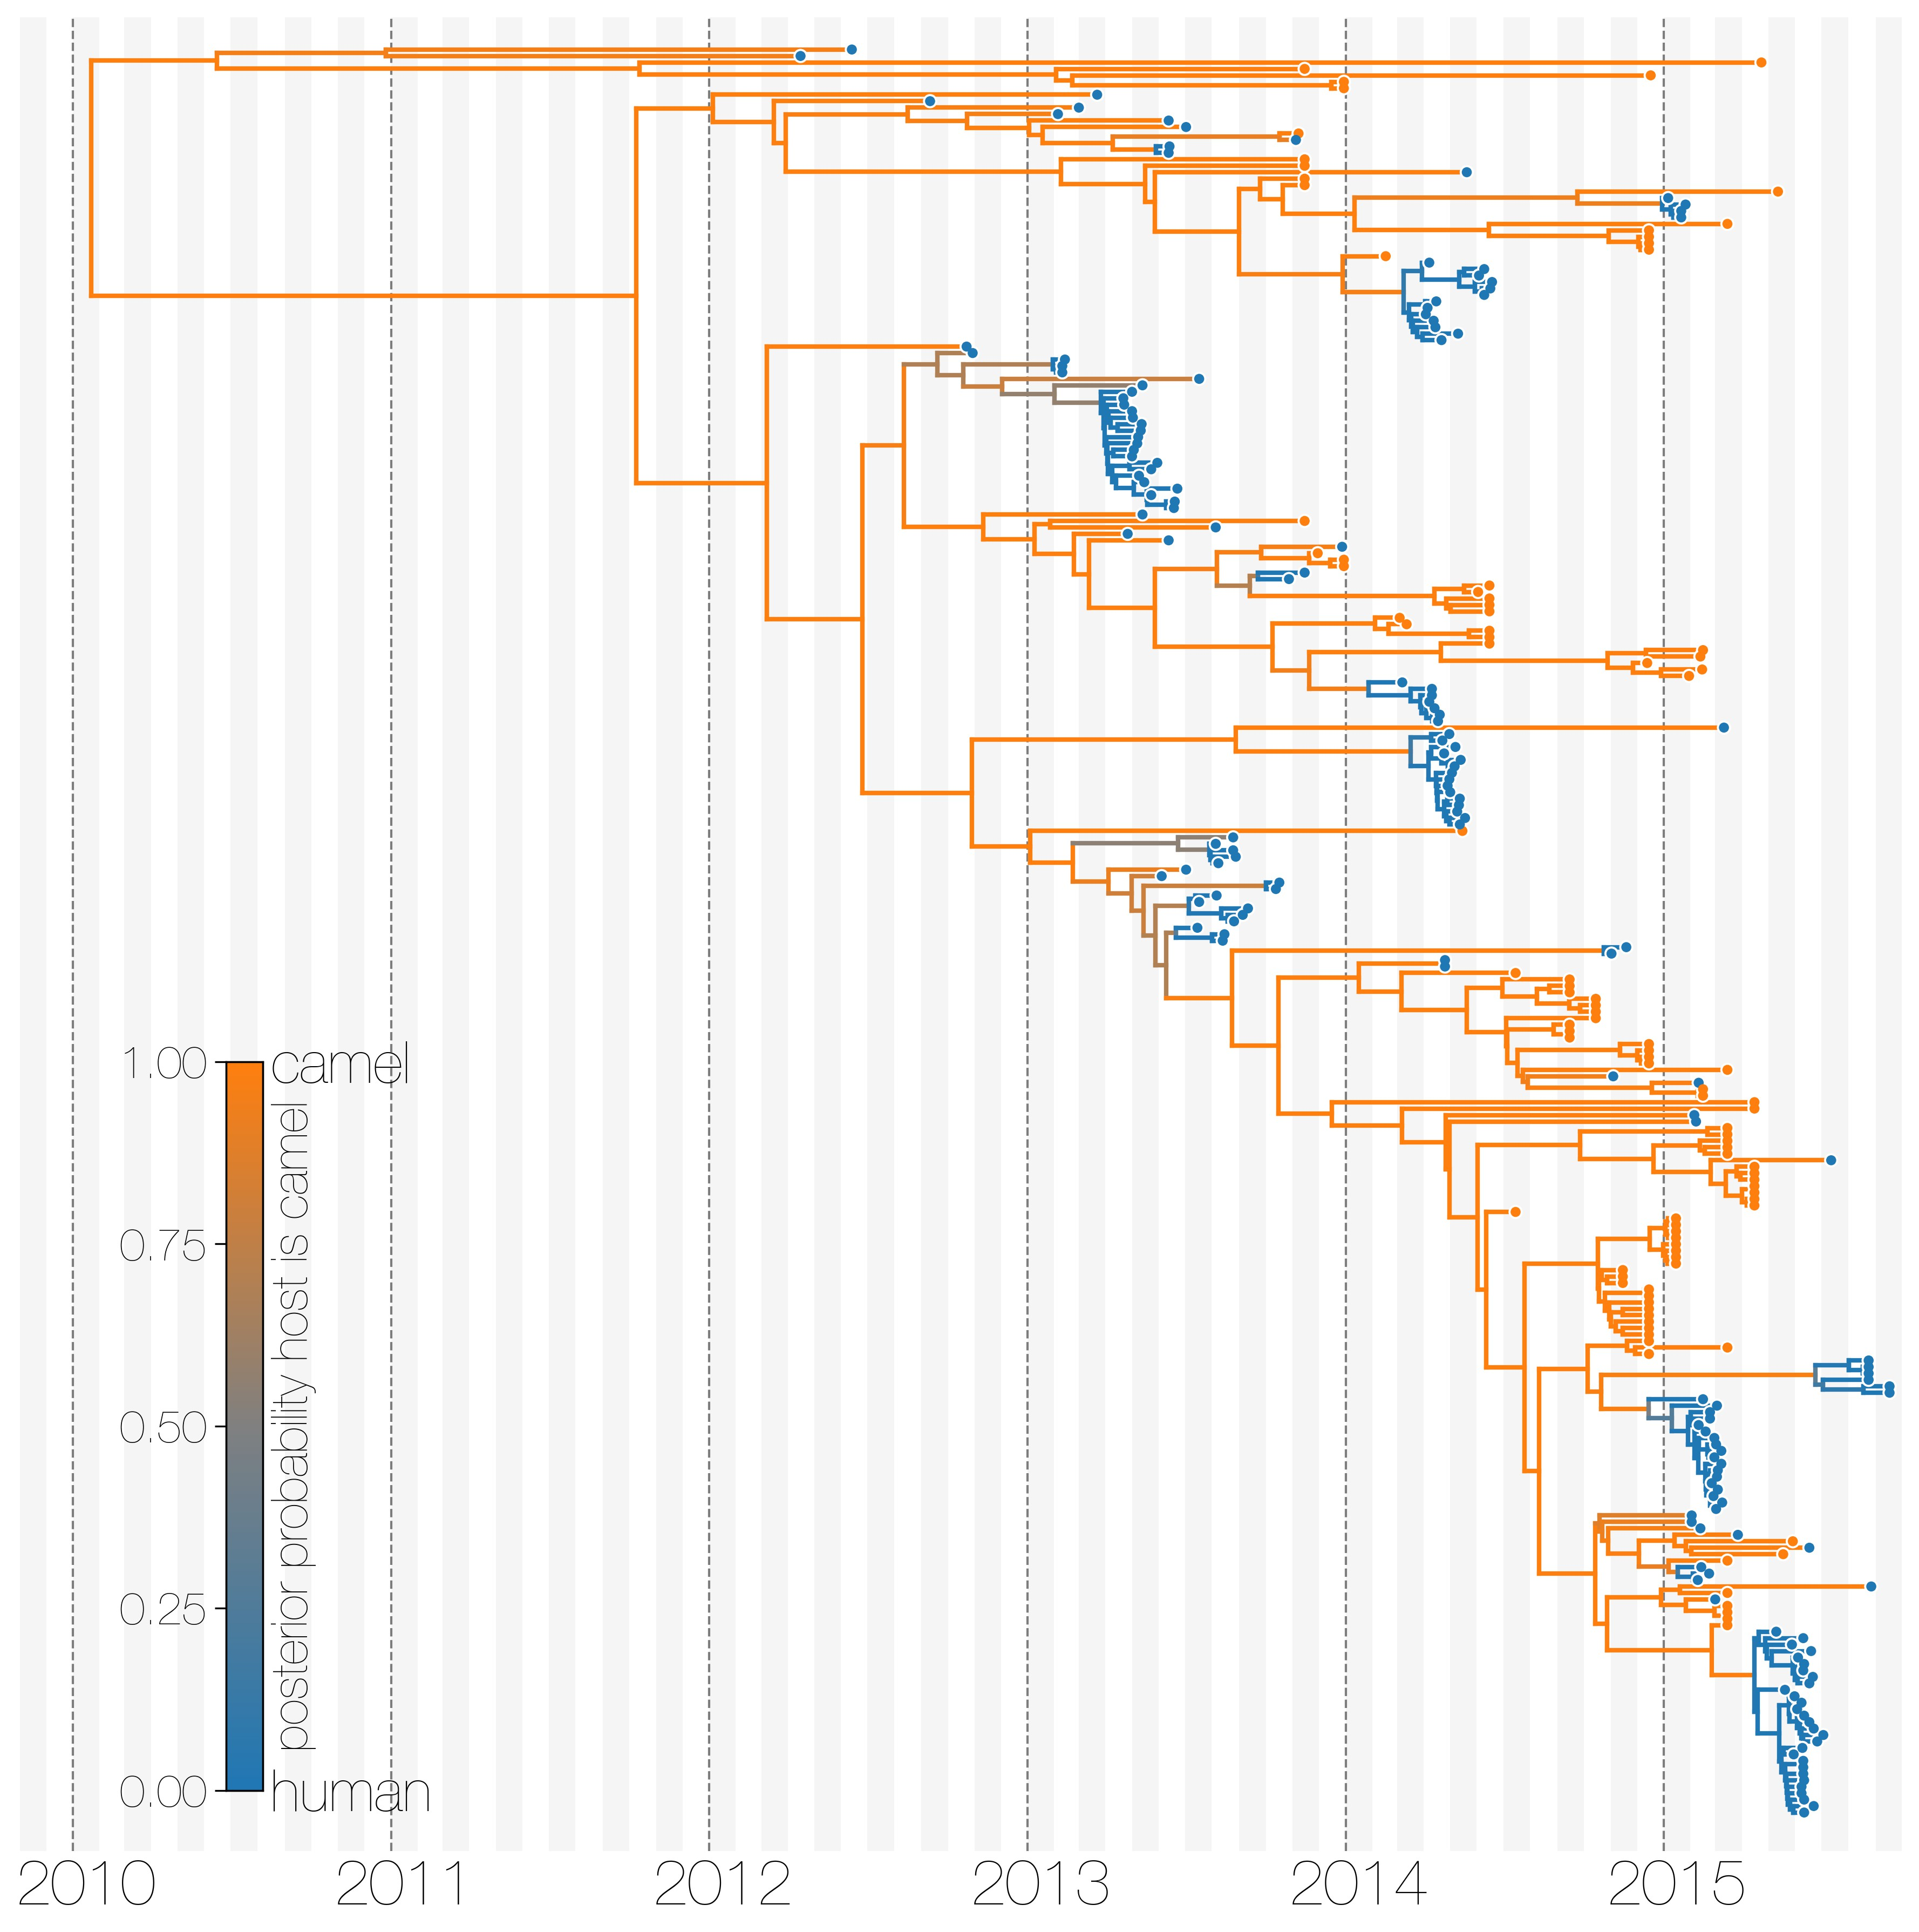
MERS sequences cluster by host of isolation
Dudas et al., 2018, eLife

Slide 5
Models to account for population structure:
DTA: Assumes structure to be a neutral trait evolving “on top” of a phylogenetic tree (Lemey 2009).
Structured Coalescent: Models how lineage coalesce within and migrate between discrete locations.
Multi-type Birth-death models: Models how lineage give birth to other lineage in the same and migrate between them.

Slide 6
Tree was generated by some different process (e.g. a coalescent process).
Slide from Timothy Vaughan

Slide 7
Root of the tree is in some location (here red)
Slide from Timothy Vaughan

Slide 8
Then models the migration process on top of this tree from the root to the tips
Slide from Timothy Vaughan

Slide 9
Sampling locations are considered Data.
Slide from Timothy Vaughan

Slide 10
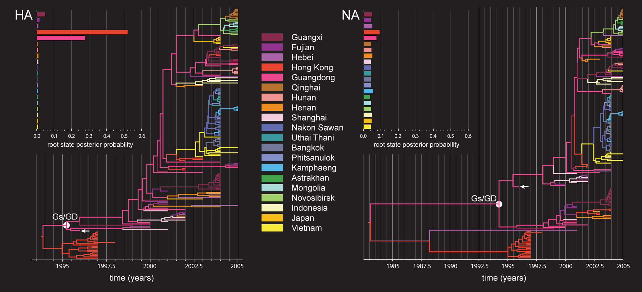
Assuming geography is a neutral trait allows to consider relatively large datasets
Lemey et al., 2009 PLoS Comp.

Slide 11
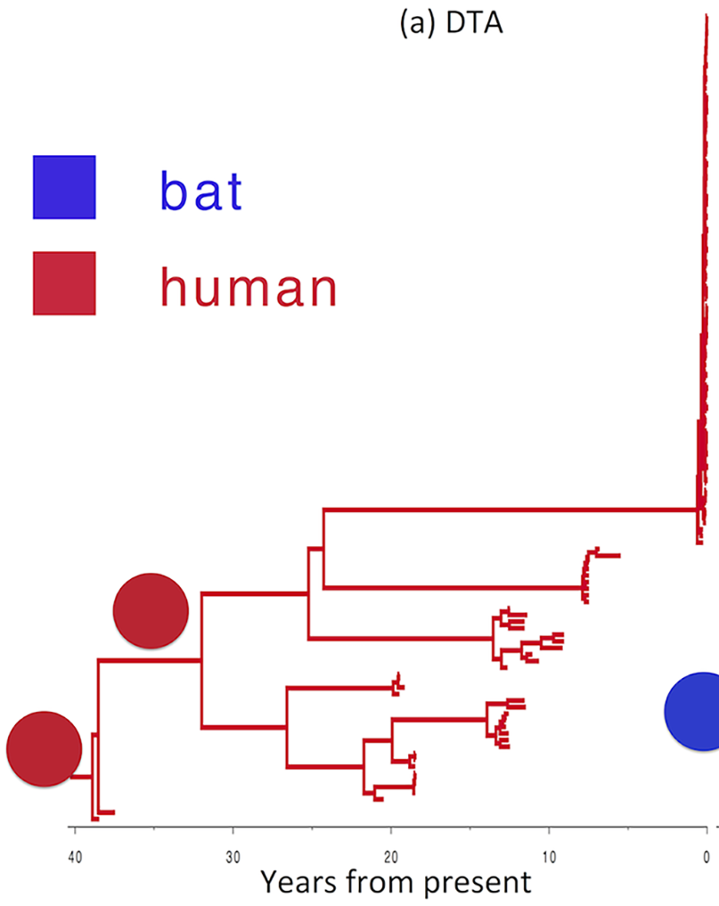
Assuming neutral traits gives sampling locations a lot of weight in the analysis
deMaio et al., 2015 PLoS Gen.

Slide 12
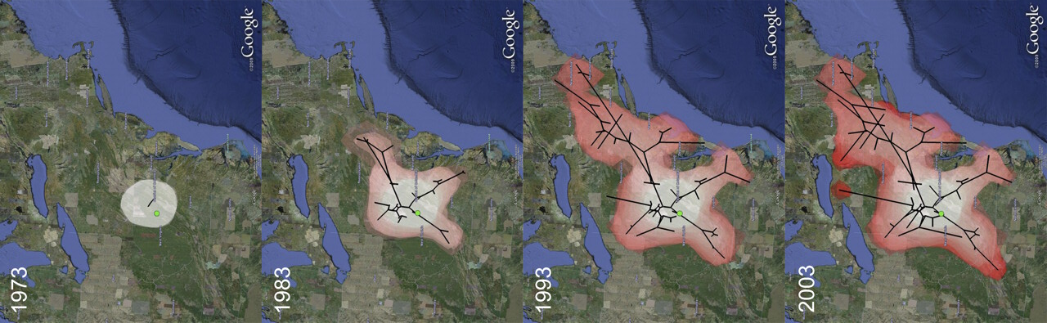
Trait evolution can happen on continuous space as well, assuming geography is a random diffusion process
Lemey et al., 2009 MBE

Slide 13
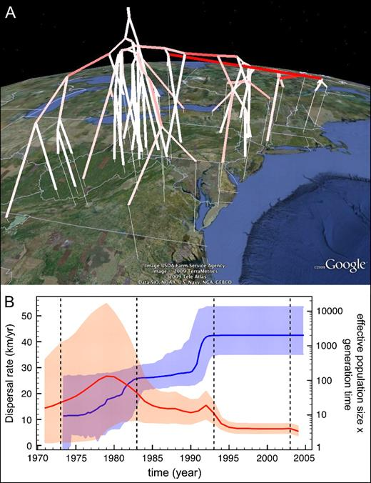
Trait evolution can happen on continuous space as well, assuming geography is a random diffusion process
Lemey et al., 2009 MBE

Slide 14
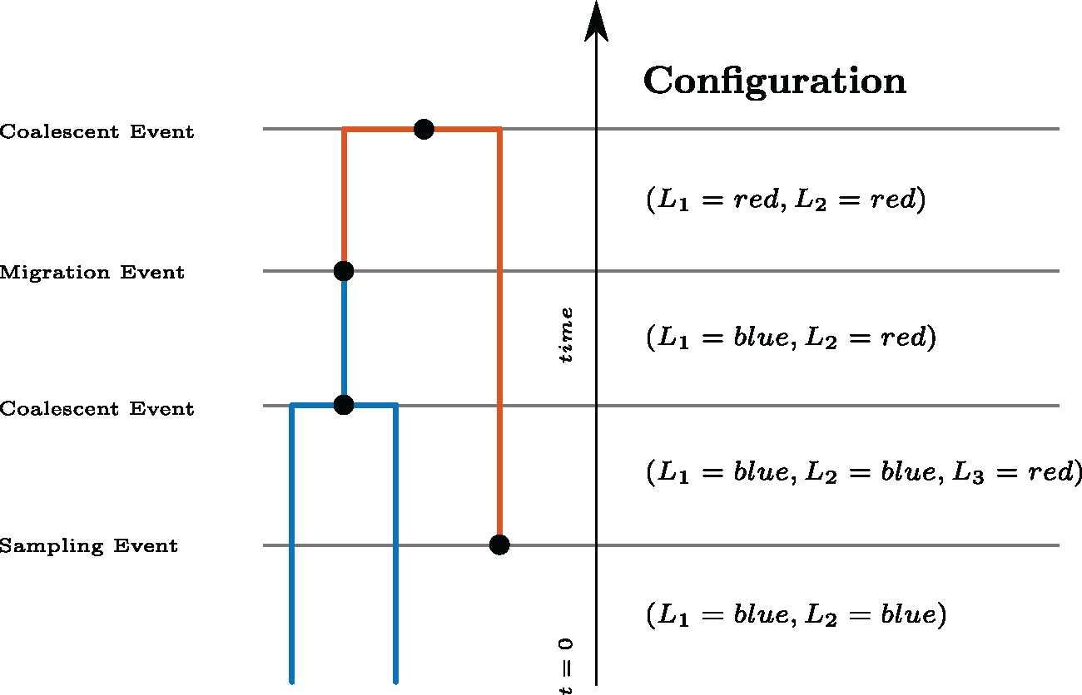
The structure coalescent model how lineage coalesce within and migrate between demes
Müller et al., 2017, MBE

Slide 15
The structure coalescent model how lineage coalesce within and migrate between demes
MultiTypeTree: Inference under the exact structured coalescent (not approximation).
Mascot: Inference under an approximate structured coalescent version (some approximation).
Basta: Inference under a more approximate structured coalescent version.

Slide 16
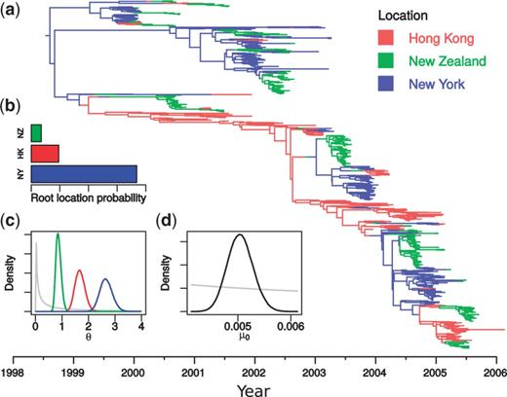
MultiTypeTree jointly infer the tree, parameters and migration histories
Vaughan et al., 2014, Bioinf.

Slide 17
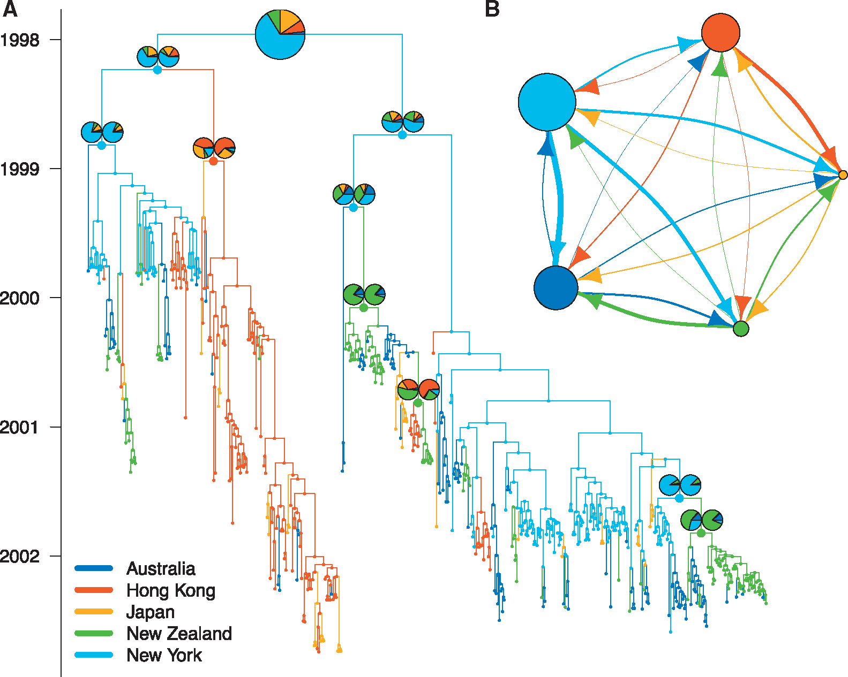
MASCOT approximates the structured coalescent to dramatically improve efficiency, by integrating over migration histories
Müller et al., 2018, Bioinf.

Slide 18
Migration rates and effective population sizes can be informed from outside data using a GLM approach

Slide 19
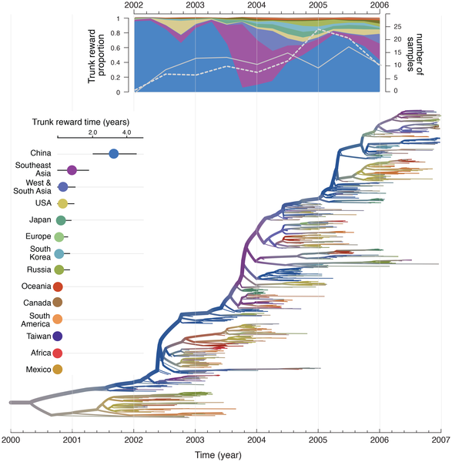
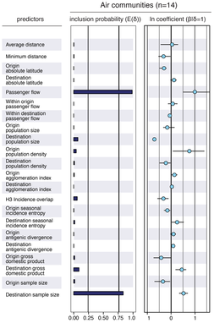
Migration rates in the DTA model can be informed by transportation Data
Lemey et al., 2014, PLoS Path.

Slide 20
Time dependent predictors can be linked to migration rates and effective population sizes
Müller et al., 2019, Virus Evol.

Slide 21
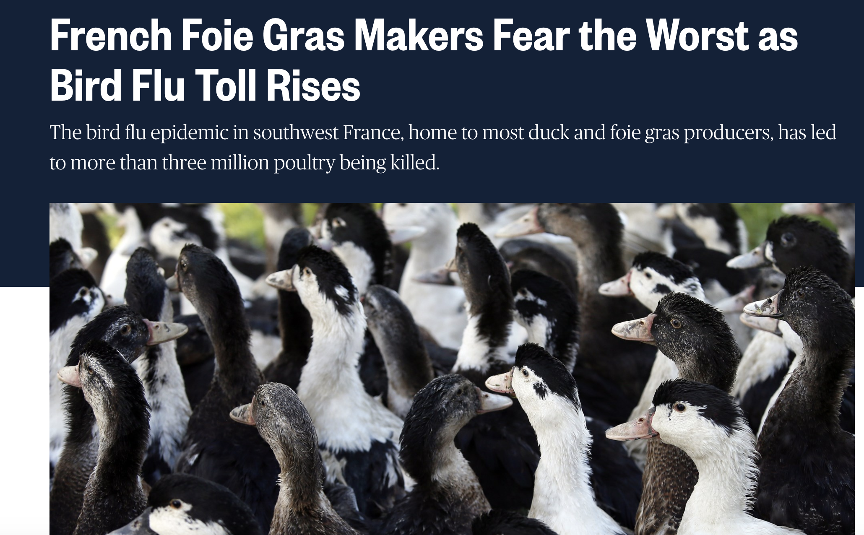
In 2016 and 2017, there was an Influenza A/H5N8 outbreak in France
https://www.nbcnews.com/news/world/french-foie-gras-makers-fear-worst-bird-flu-toll-rises-n721276
Notes:
In 2016 and 2017, there was an outbreak of influenza A/H5N8 in France.
This outbreak mainly took place in the fois gras growing region.
To study the spread of H5N8, influenza A/H5N8 sequences isolated from different farms in different department were sequenced.

Slide 22
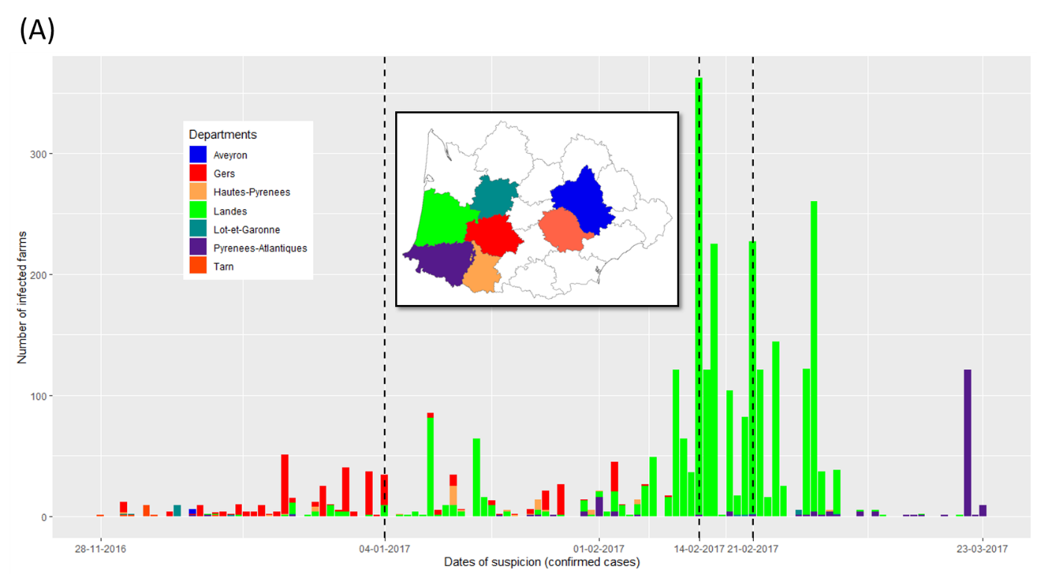
Cases first appeared in the department (state) of tarn and H5N8 was soon detected in other regions as well
Chakraborty et al., 2021, BioRxiv
Notes:
These sequences originated from different departments in the South of France.
They were first isolated in the department of tarn and then spread through the region.

Slide 23
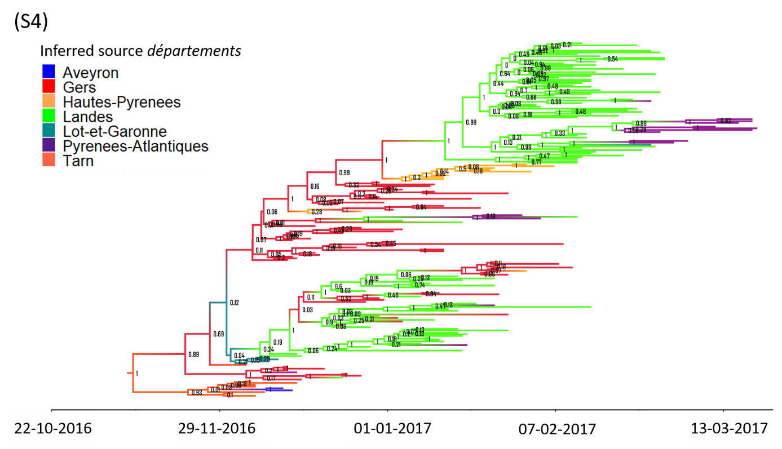
MASCOT-GLM reconstructs Tarn to be the most likely source, consistent with case data
Chakraborty et al., 2021, BioRxiv
Notes:
We then used the structured coalescent to infer how and between which departments H5N8 was spread.
Additionally, we inferred what predictors potentially correlated with these transmission dynamics.
In particular, there were different culling events that took place in order to reduced the spread of avian influenza A/H5N8.
We can use the timings of these events as potential predicts of how transmission dynamics changed between departements.

Slide 24
Not accounting for population dynamics can impact the inference of ancestral states
In preparation

Slide 25
Ancestral state reconstruction of ZIKV in South America looks completely different based on whether population dynamics are accounted for nor not
In preparation

Slide 26
Population dynamics reconstruction looks different based on whether population structure is accounted for nor not
In preparation

Slide 27
Population dynamics reconstruction looks different based on whether population structure is accounted for nor not
In preparation

Slide 28
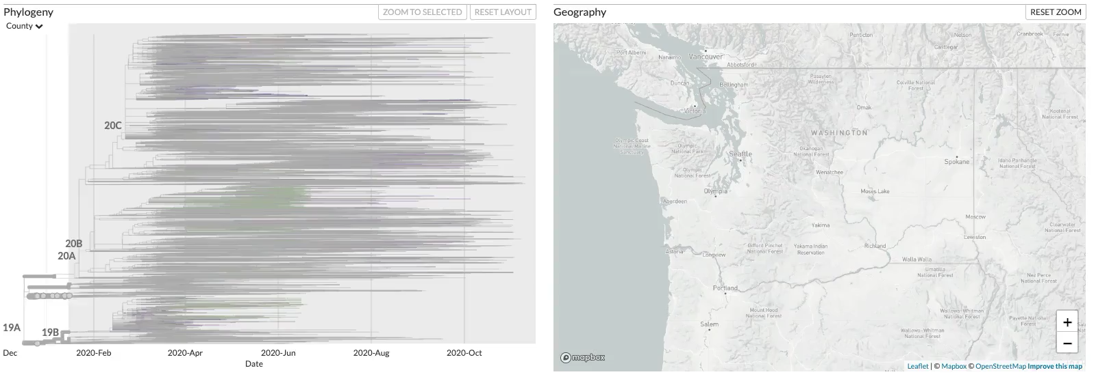
Phylogenetic tree of SARS-CoV-2 sequences isolated in Washington State reveal multiple introductions.
https://nextstrain.org/groups/blab/ncov/wa-phylodynamics?c=county
Notes:
Here, I show phylogenetic tree reconstructed from SARS-CoV-2 sequences isolated in Washington State and around to world, where samples from Washington State are colored based on the county they were isolated in.
After an initial introduction, SARS-CoV-2 spread mostly around Seattle, but more widespread around the state soon thereafter.
Viruses introduced early differed from those later, most notably by a amino acid substitution in the spike protein.
These two variants are referred to as 614D and 614G.

Slide 29
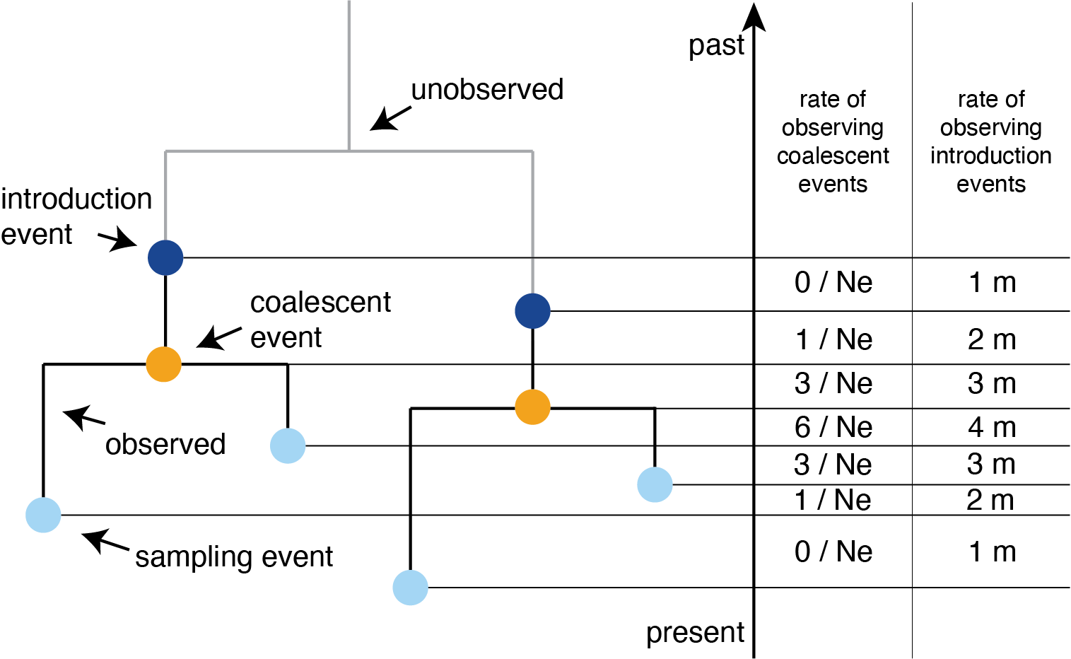
“Multitree” models to model population structure with an unstructured model
Müller et al. (2021), Sci. Trans. Med.
Notes:
We used phylodynamic approaches to study how the case load of the two different variants changed over time.
Reconstructing the effective population size, as measure proportional to the number of infected over time, of the spike variants reveals different temporal patterns.
614D dominated early, but soon declined, while 614G cases peaked much later.

Slide 30
Reconstructing the effective population size of the spike variants reveals different temporal patterns
Müller et al. (2021), Sci. Trans. Med.
Notes:
We used phylodynamic approaches to study how the case load of the two different variants changed over time.
Reconstructing the effective population size, as measure proportional to the number of infected over time, of the spike variants reveals different temporal patterns.
614D dominated early, but soon declined, while 614G cases peaked much later.

Slide 31
Introductions played different roles in the spread of different SARS-CoV-2 spike variants
Müller et al. (2021), Sci. Trans. Med.
Notes:
We can also use these phylodynamic methods to get an idea of how important introductions are in driving cases.
What we find is that introductions from outside the state played only a minor role (after the initial introduction) in driving cases of 614D, but played a major role in driving 614G cases, the dominant variant at that time in Europe and the North East of the US.
This suggest that the changes in local frequencies of the two different spike variants very driven by different timings of when local measure were introduced and by a large number of introductions of 614G viruses from outside the state.

Slide 32
Multi-type birth-death process
N types, i = 1,…,N
N birth rates λ_{i}
N death rates μ_{i}
N sampling rates ψ_{i}
Migration rates m_{i,j} ∀ i ≠ j
Kühnert et al. MBE, 2016

Slide 33
Variations
Typed or untyped trees, i.e. trees including the migration history or not (BDMM)
Fixed types at the tips (BDMM) or estimated (MSBD)
Extended multi-type birth-death model with birth rate between demes λ_{i,j} ∀ i ≠ j (BDMM, XML only)

Slide 34
Pros / Cons
Pro: parameter estimates map to biologically meaningful quantities (R₀, length of infectious period, etc)
Con: computational cost (BDMM) or approximations (MSBD)
Con: sensitive to unmodelled sampling discrepancies

Slide 35
Example: tuberculosis
Pečerska et al., 2021, Epidemics

Slide 36
QUESTIONS?

Slide 37
Some reading material
Modeling geography as a discrete neutral trait: https://doi.org/10.1371/journal.pcbi.1000520
GLM for neutral traits: https://doi.org/10.1371/journal.ppat.1003932
How do different structured coalescent approximations compare: https://academic.oup.com/mbe/article-abstract/34/11/2970/3896419
Birth-death models with migration: https://doi.org/10.1093/molbev/msw064

Slide 38
Some reading material
GLM for MASCOT: https://doi.org/10.1093/ve/vez030
Avoiding having to use structured methods: https://stm.sciencemag.org/content/13/595/eabf0202.abstract
Modelling SIR dynamics: https://journals.plos.org/ploscompbiol/article?id=10.1371/journal.pcbi.1006546

